Slide 1
Web development II
Application State

Slide 2
state
The condition of a program at a point in time.
The stored inputs and variables
Consider the state of objects in science, gas, liquid or solid; a computer state is its current values.

Slide 3

State
We can think of application as being ‘stateful’.
We can describe an application by it’s currently held values
Consider the game tic tac toe
Each square can be empty, X, or O
Can be described as an array:
[][][][][][][][][] or [[],[],[]], [[],[],[]], [[],[],[]]

Slide 4
State
X
X
O
Define an initial state
In addition to an empty play area we need to decide who goes first.
When defining a state, the values need to be discrete. They either are or aren’t.
Let’s say X always starts.
Define our inputs. Here a move is an input.
O, then X, and so on until the board is filled or 3 in a row are matched.
X
O
O

Slide 5
State
X
O
Whose turn is it?
Since X plays first and there is only one O on the board, it must be O’s turn to play.
This is what makes describing applications as states useful. It allows us to look at our programs from a distance an describe complex behavior.
We can also separate how an application looks from how it works.
X

Slide 6
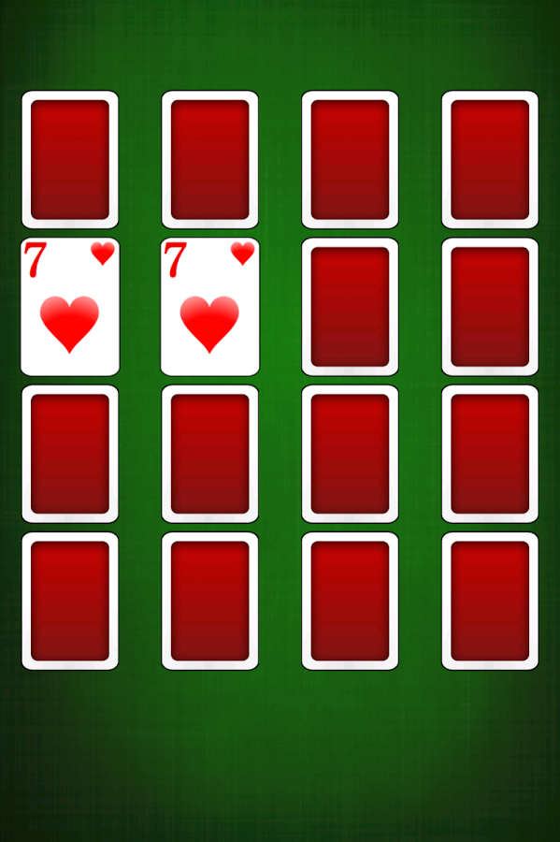
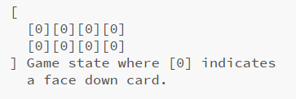
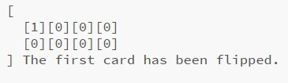
A Game of Object States
Let’s consider a more complex game.
Here our game can be described as a series of cards, that are either flipped or not.
If we flip over two cards in a row that have the same value they get to stay flipped.
Otherwise they must be flipped back over.
We win when all cards are flipped.

Slide 7
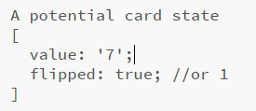
A Game of Object States
A single card contains more information than just X or O
We also can’t have an ‘empty’ card
We can describe our card by value, and flipped or not flipped

Slide 8
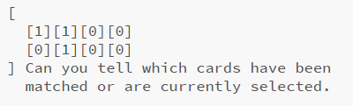
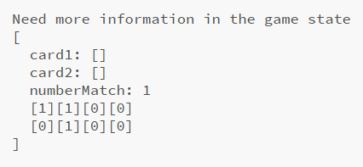
A Game of Object States
Defining behavior for complex states may require more information than the state may describe.
In our case we can determine which card is selected using it’s value and the fact that a pair has to match to remain flipped.
It may be helpful to create reference to certain objects.

Slide 9
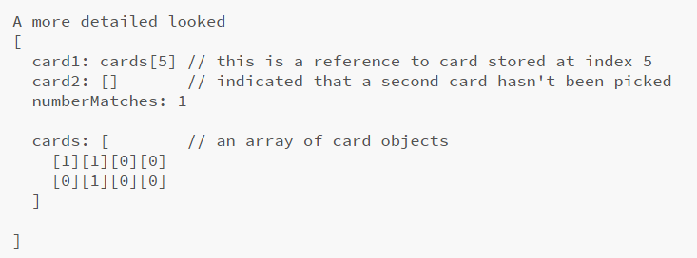
A game of object states

Slide 10
Summary
Applications can be described as a state
Describing our application’s state can help us design and develop our application.
We can write our application’s behavior as inputs that change the state.

